Slide 1








Breast cancer detection
Ahmed Ali Mohamed
Khaled Ahmed Eldfry
Omar Wael Elsharkawy
Heba Amgad Saed
Maram Tarek Elsayed

Slide 2

INTRODUCTION
What is Breast Cancer?
A form of cancer where cells grow uncontrollably in breast tissues.
Early detection greatly increases survival chances.
The Problem:
Diagnosing cancer traditionally requires time-consuming lab work and is prone to human error.
Solution Offered:
Use machine learning algorithms to predict if a tumor is benign or malignant based on data patterns.

Slide 3
Problems
For Detection
For Diagnosis
For Treatment options
For Side Effects
One of the primary concerns with breast cancer is early detection. Detecting breast cancer in its early stages greatly increases the chances of successful treatment.
Diagnosing breast cancer requires a combination of imaging tests, such as mammograms and ultrasounds, and tissue biopsies.
Breast cancer treatment methods can vary depending on the type and stage of cancer
Breast cancer treatments can have various side effects, including fatigue, hair loss, nausea, weight changes, pain, and emotional distress.

Slide 4
Popular Solution
MRI
(Magnetic Resonance Imaging)
n some cases, MRI may be recommended, particularly for women at high risk of breast cancer or to further evaluate abnormalities found on mammograms or ultrasounds.

Slide 5


Our Solution
Using AI for breast cancer detection involves leveraging advanced algorithms and machine learning techniques to analyze medical images, such as mammograms, and magnetic resonance imaging (MRI) scans.

Slide 6
Objectives of the Project
Main Goal: Build a machine learning model that predicts tumor type with high accuracy.
Secondary Goals:
Automate diagnosis and support medical decisions.
Improve diagnostic speed and accuracy

Slide 7
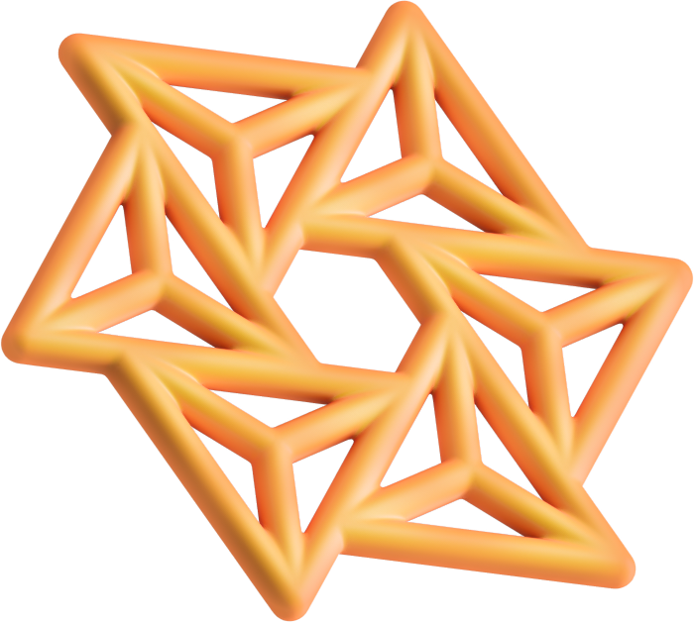
Motivation for the Project
Why this project matters:
Breast cancer affects millions of women annually.
Machine learning models provide reliable, fast, and scalable solutions.
Integrating AI can assist doctors and reduce diagnostic errors.

Slide 8

Dataset
Dataset Source: UCI Breast Cancer Wisconsin Dataset
Dataset Details:
569 instances, 30 numerical features.
Target Variable: Diagnosis
0 = Benign
1 = Malignant
Features Include:
Radius, Perimeter, Texture, Area, Smoothness
Compactness, Concavity, Symmetry, Fractal Dimension

Slide 9
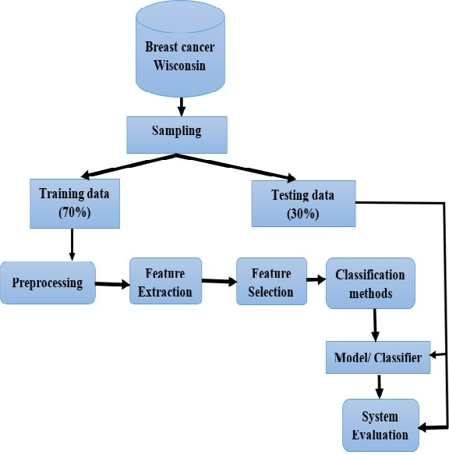
Architecture Diagram
This diagram illustrates the architecture of the Breast Cancer Prediction System. It breaks down the steps involved in building a machine learning model for classifying tumors (benign or malignant).
Data is loaded from the Wisconsin dataset.
Preprocessing and feature extraction steps ensure that the data is ready for machine learning.
The data is split into training and testing subsets.
Machine learning models are trained using the training data.
The trained models are evaluated using metrics on the testing data to determine their performance.

Slide 10
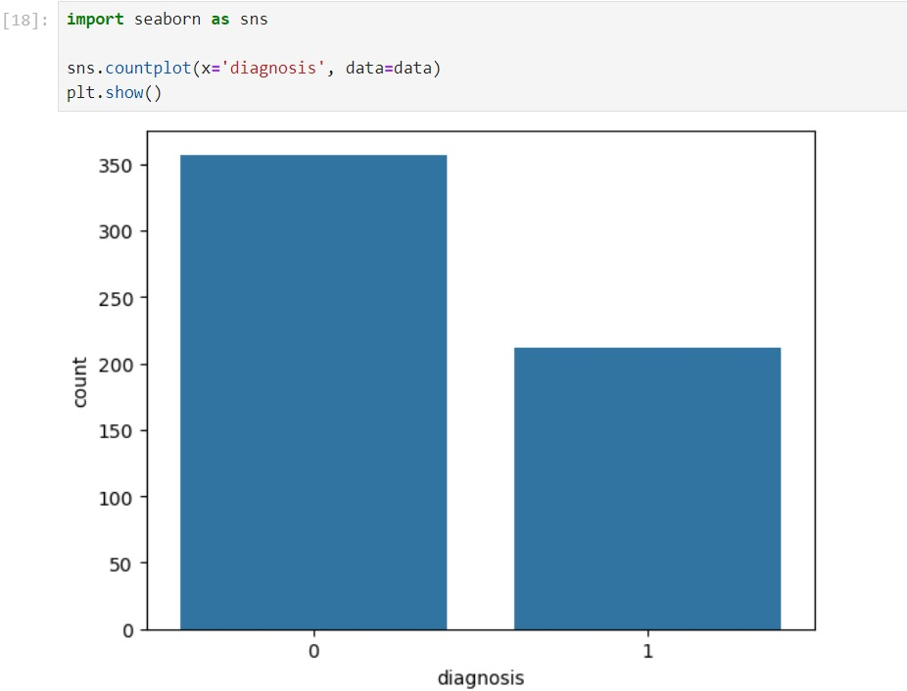
Data Analysis & Visualization
Exploratory Data Analysis (EDA)
How are malignant and benign cases distributed?

Slide 11
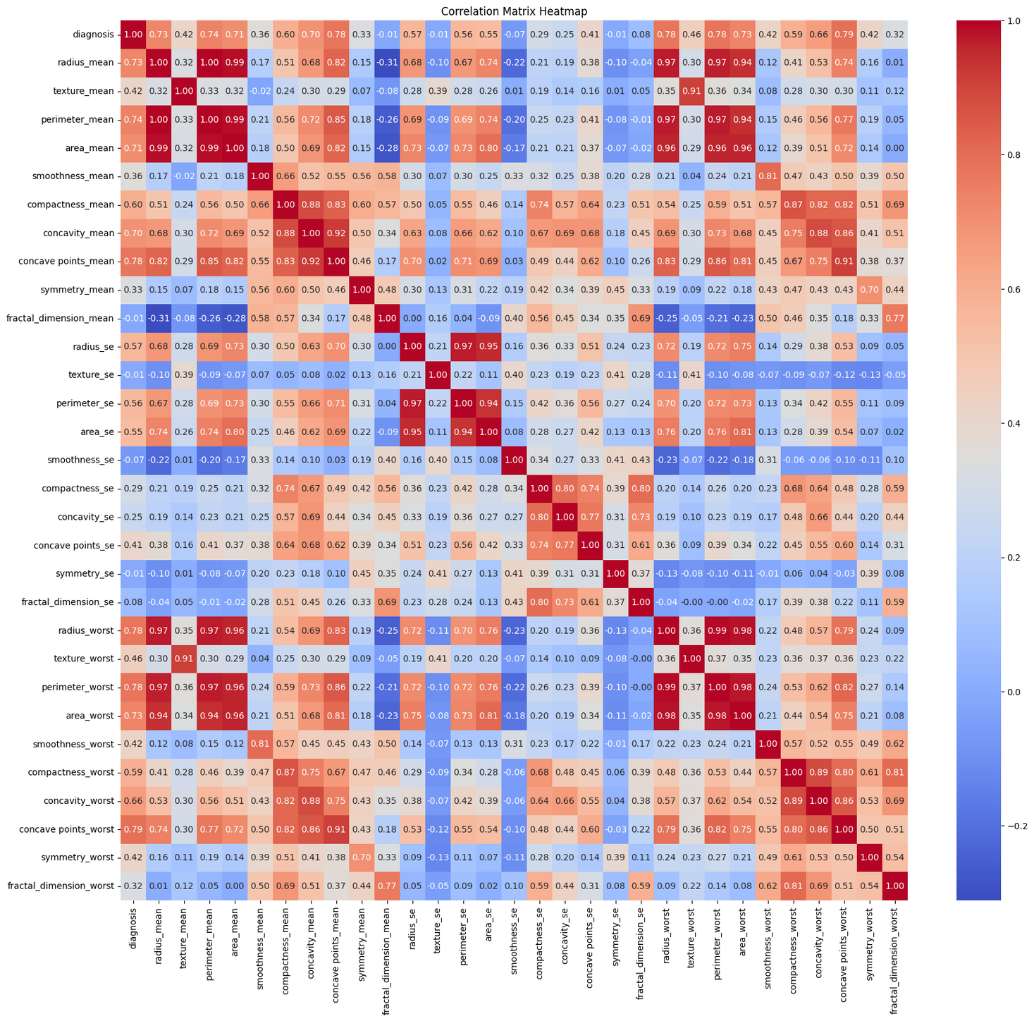
Correlation Heatmap
Purpose: Identify relationships between features to avoid redundancy.

Slide 12
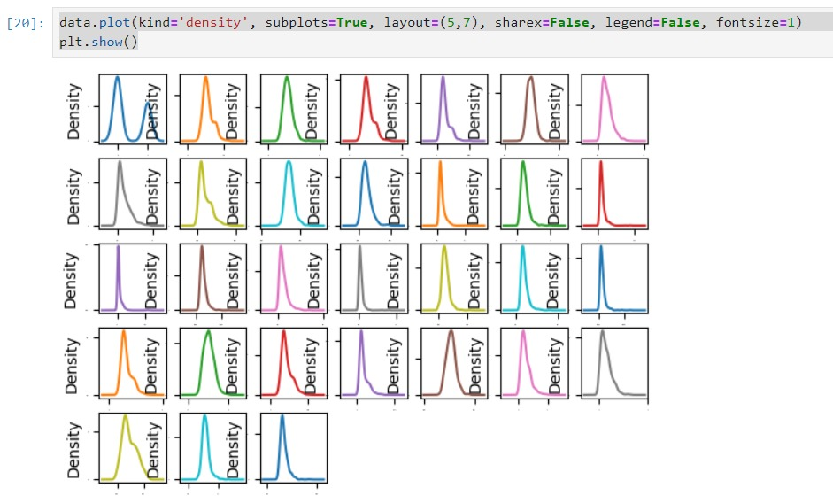
Visualizing Data Distribution: Density plots provide a clear visualization of how data points are distributed across different values, helping to identify patterns and trends.
Detecting Normality: They can help assess whether the data follows a normal distribution, which is crucial for many statistical analyses.

Slide 13
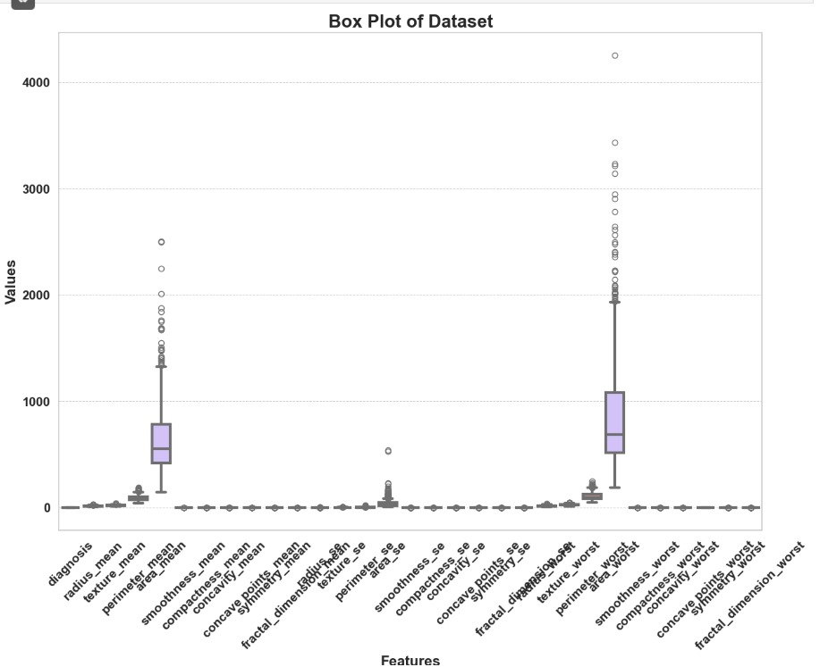
Data Distribution Visualization: Box plots provide a visual summary of the data distribution, highlighting the median, quartiles, and potential outliers.
Outlier Detection: They make it easy to identify outliers, which are crucial for understanding the variability of the data.

Slide 14
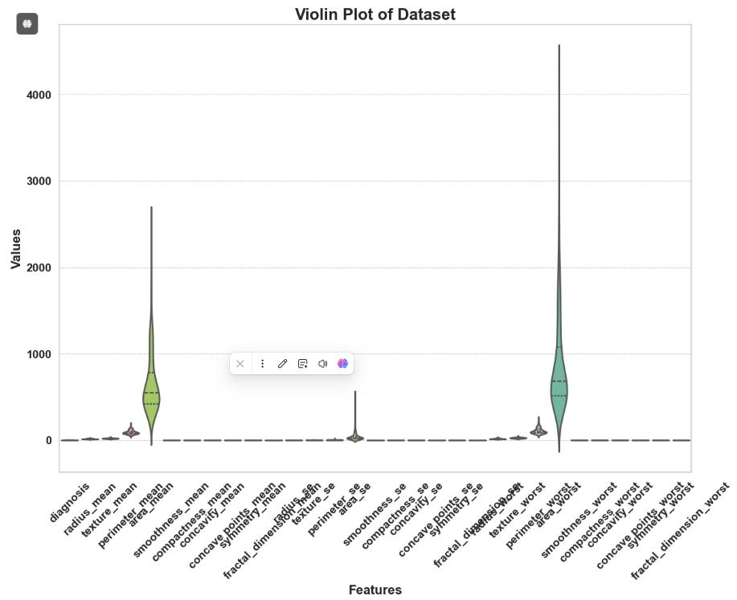
Data Distribution Visualization: Violin plots provide a comprehensive view of the distribution of the data across different categories, showing the density of the data points at various values.
Outlier Identification: Similar to box plots, violin plots can help identify outliers and provide insights into the overall distribution, helping to detect anomalies in the dataset.

Slide 15
Data Modeling

Slide 16

Algorithms :
LogisticRegression
Random Forests
Support Vector Machines
KNeighborsClassifier
DecisionTreeClassifier

Slide 17
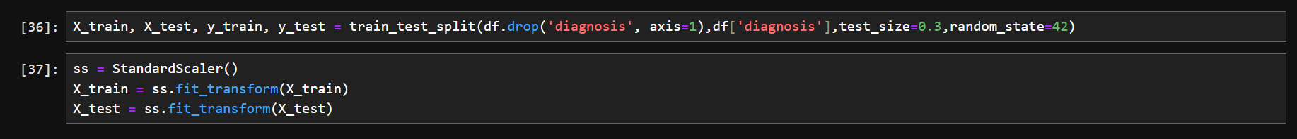
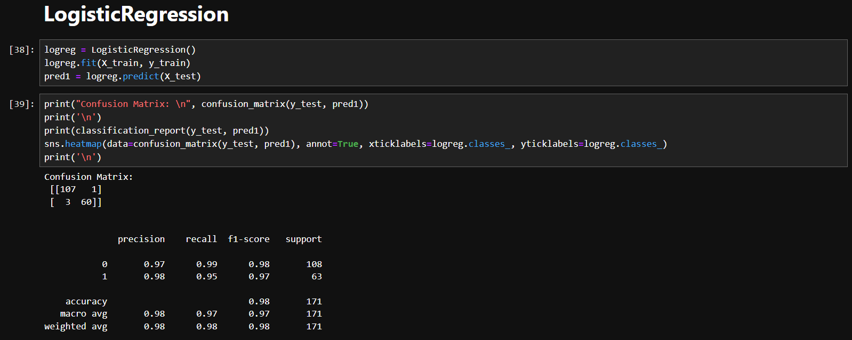
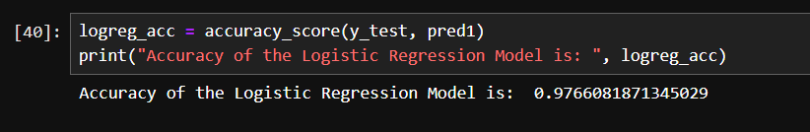
In the firs we split the dataset into training and testing sets using train_test_split, and then both the training and testing feature sets are standardized using StandardScaler to improve model performance.
LogisticRegression
A Logistic Regression model is trained on the dataset, predictions are made, and model performance is evaluated using a confusion matrix and classification report. The confusion matrix shows correct and incorrect predictions, while the classification report provides precision, recall, and F1-score metrics.

Slide 18
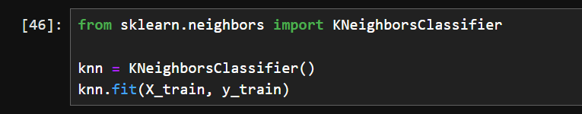
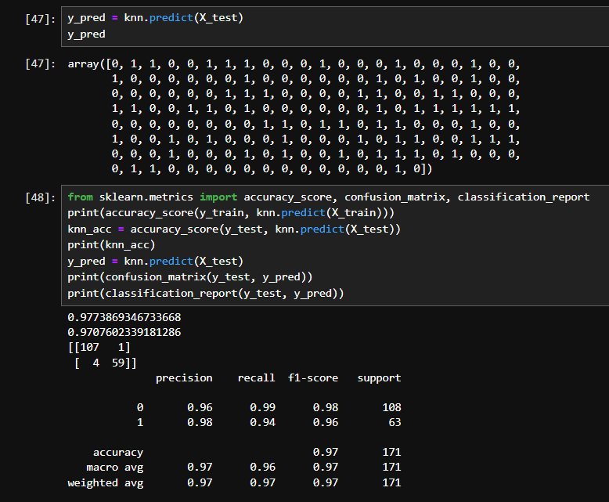
KNeighborsClassifier
A K-Nearest Neighbors (KNN) classifier is trained on the training data and evaluated on the test data. The performance is measured using the confusion matrix and classification metrics such as precision, recall, and F1-score. The KNN model achieves an accuracy of 97.1% on the test set, with high precision and recall across both classes.

Slide 19
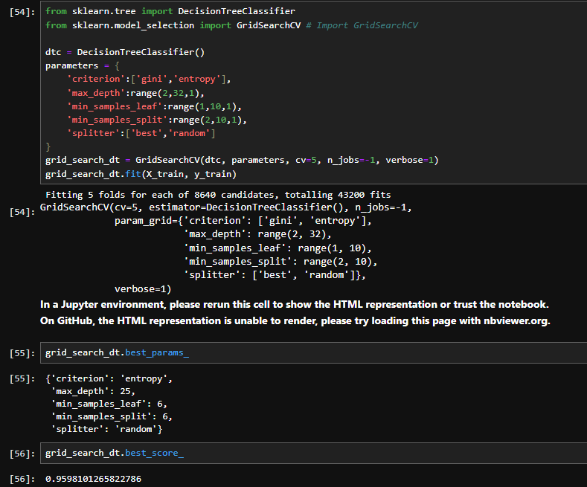
DecisionTreeClassifier
The code performs hyperparameter tuning for a Decision Tree classifier using GridSearchCV . The search is conducted over a wide range of parameters such as the splitting criterion, maximum depth, minimum samples per leaf, and the type of splitter. The grid search evaluates 43,200 different model configurations across 5-fold cross-validation. The best model parameters found are:
Criterion: 'entropy'
Max depth: 25
Min samples per leaf: 6
Min samples per split: 6
Splitter: 'random'
The best cross-validation score achieved with these parameters is 95.98%.

Slide 20
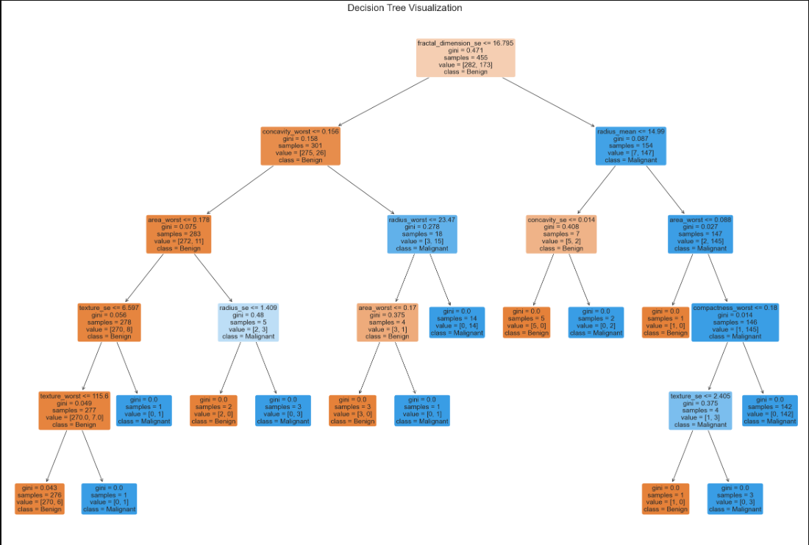
DecisionTreeClassifier

Slide 21
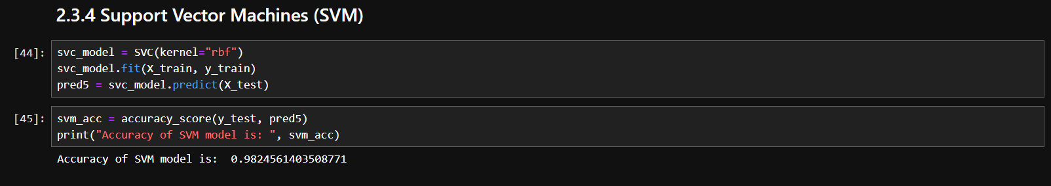
SVM
A Support Vector Machine (SVM) model with an RBF kernel is trained on the dataset. The model is evaluated on the test set, and the accuracy is calculated using accuracy_score, The SVM model achieves an accuracy of 98.25% on the test data.

Slide 22
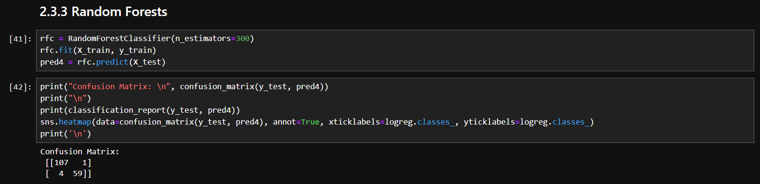
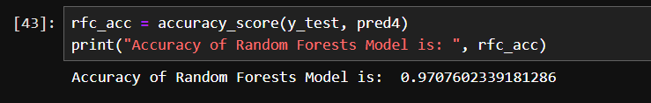
Random Forests
We implemented a Random Forest classifier with 300 estimators. After training the model, predictions are made on the test set, and performance is evaluated using a confusion matrix and classification report. The confusion matrix visualizes true and false predictions, while the classification report provides precision, recall, and F1-score metrics.

Slide 23
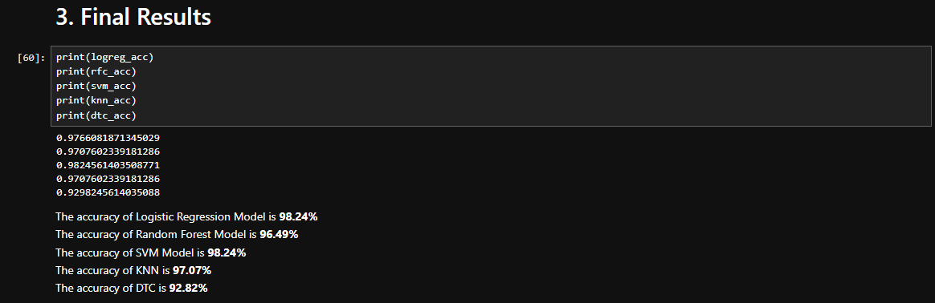
Final Results

Slide 24
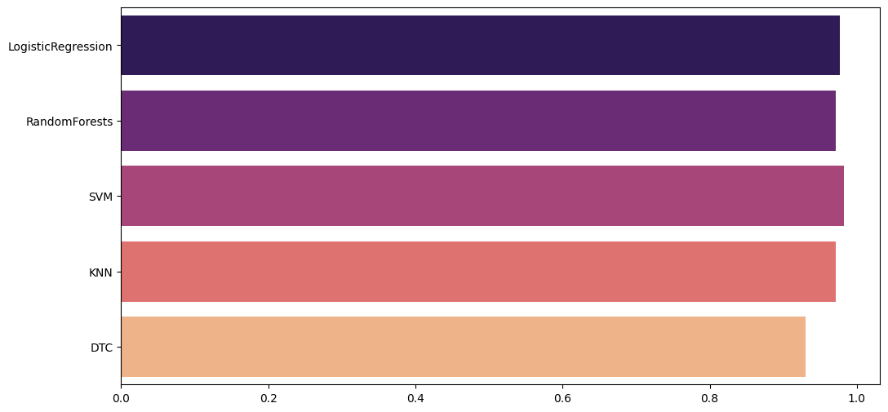
Final Results

Slide 25
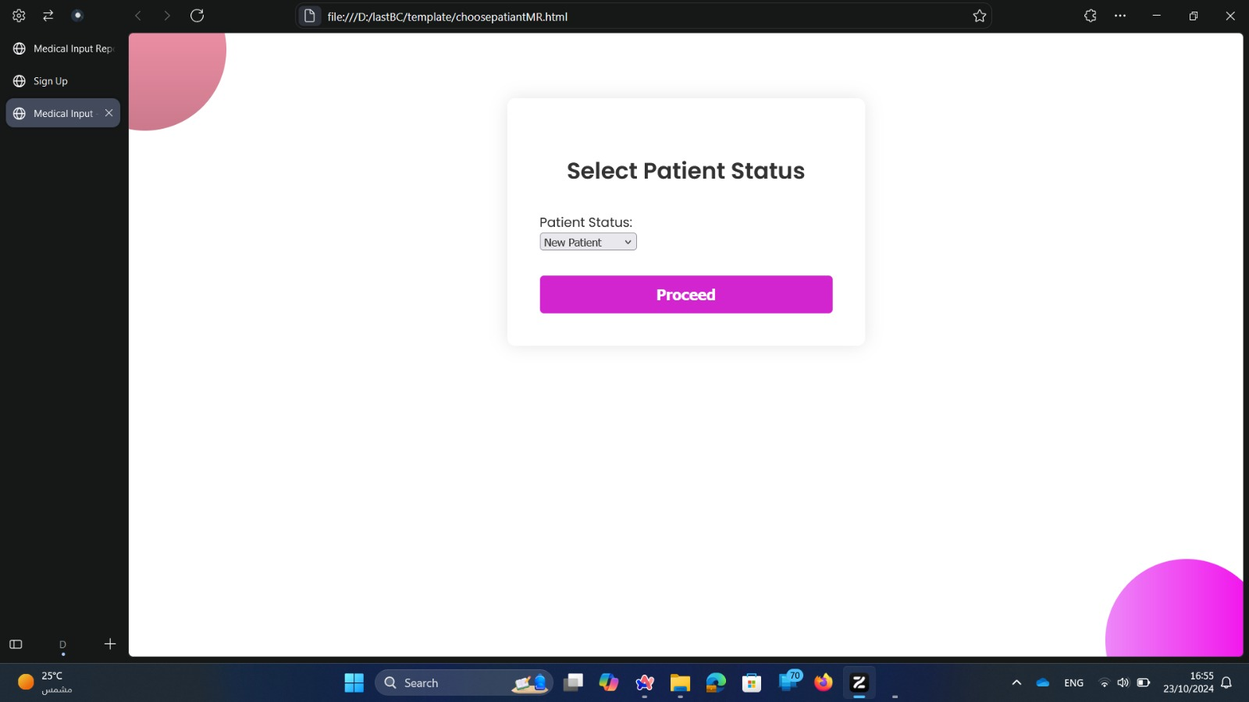

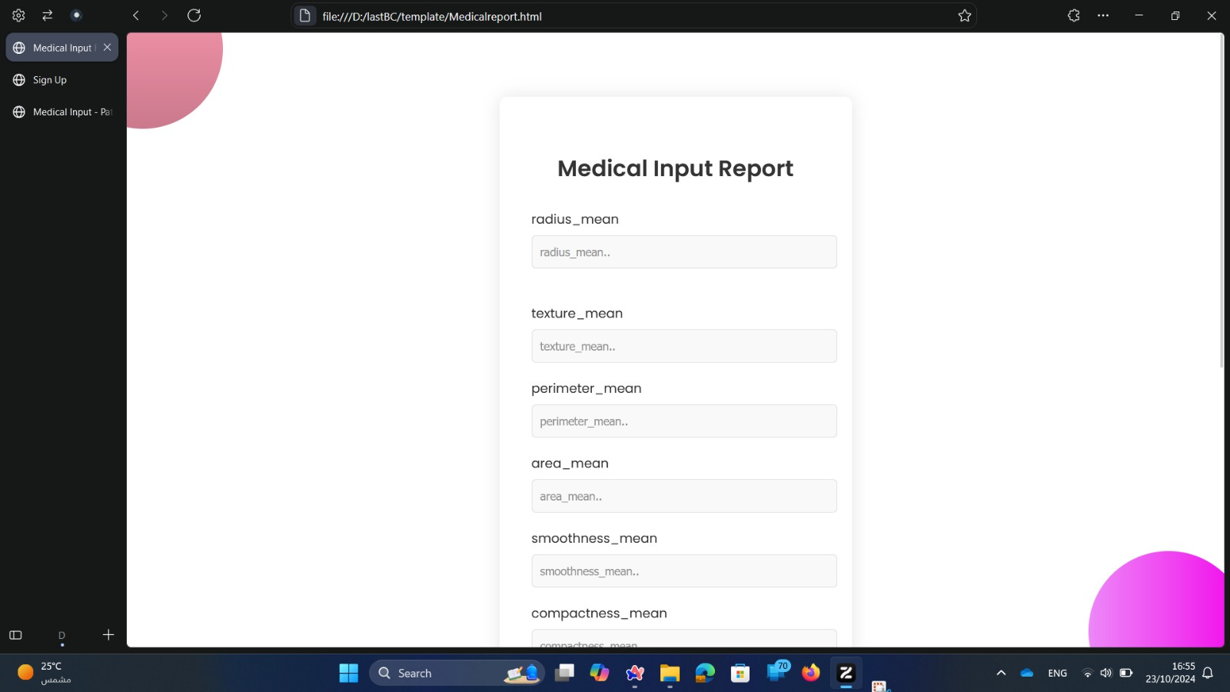
Model Deployment

Slide 26
Thank You ♥

